Slide 1
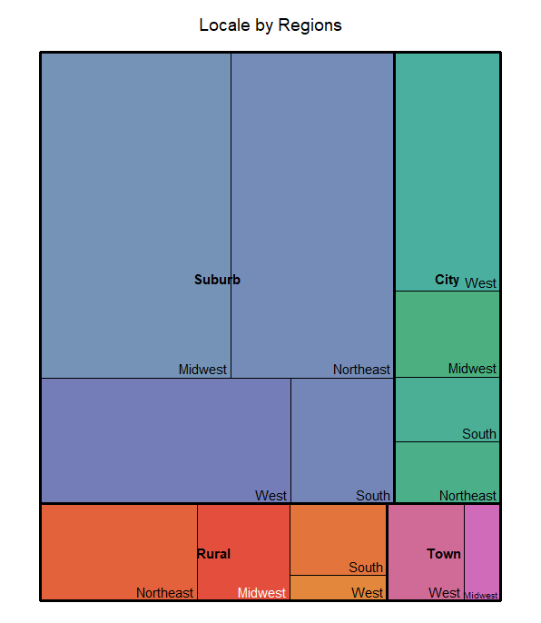
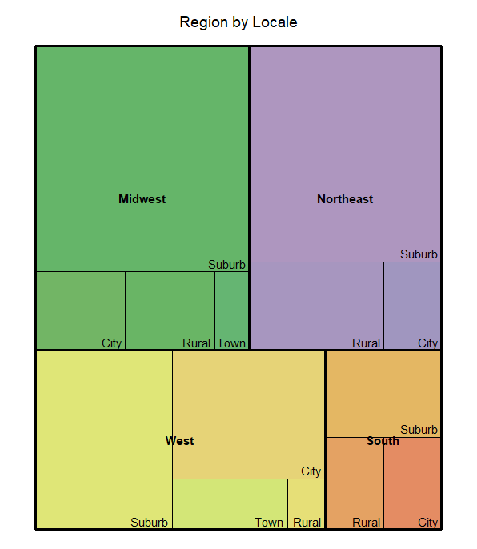
Geographical Breakdown of the Data
Locale by Region
Region by Locale
In the year 2020, the COVID-19 Pandemic swept the globe causing global shutdowns of businesses and schools. In an attempt to adapt, schools implemented digital learning. The following is data courtesy of LearnPlatform to investigate the region and locale of schools during this time. Our hopes are to build profile data for advising schools to increase digital engagement.
BACKGROUND
There are 2 tree maps that compare relative difference across Locale in the United States (Suburb, City, Rural, Town) and Region in the United States (Midwest, Northeast, West, South).
GRAPHS
Locale by Region:
The majority of the dataset is comprised of Suburb data. This is defined as “Territory outside a principal city and inside an urbanized area” (NCES).
Region by Locale:
Midwest, Northeast, and West Regions have roughly equal representation in the dataset. The South has less representation.
We want to consider these geolocational factors when making recommendations to increase digital learning engagement.
TAKEAWAYS
MSDS 455 | Fall 2023 | Kay Quiballo
Source: https://www.kaggle.com/competitions/learnplatform-covid19-impact-on-digital-learning/data

